Slide 1
Basic concepts
Networks must be able to transfer data from one device to another with complete accuracy.
Data can be corrupted during transmission.
For reliable communication, errors must be detected and corrected.
Error detection and correction are implemented either at the data link layer or the transport layer of the OSI model.

Slide 2
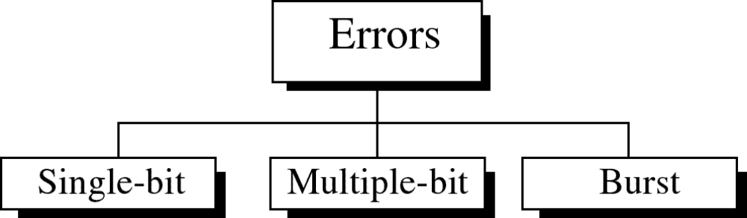
Types of Errors

Slide 3
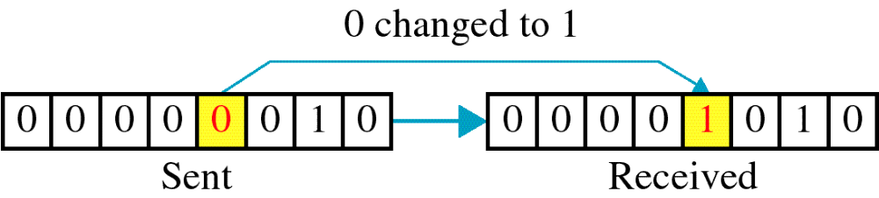
Single-bit error

Slide 4
Single bit errors are the least likely type of errors in serial data transmission because the noise must have a very short duration which is very rare. However this kind of errors can happen in parallel transmission.
Example:
If data is sent at 1Mbps then each bit lasts only 1/1,000,000 sec. or 1 μs.
For a single-bit error to occur, the noise must have a duration of only 1 μs, which is very rare.

Slide 5
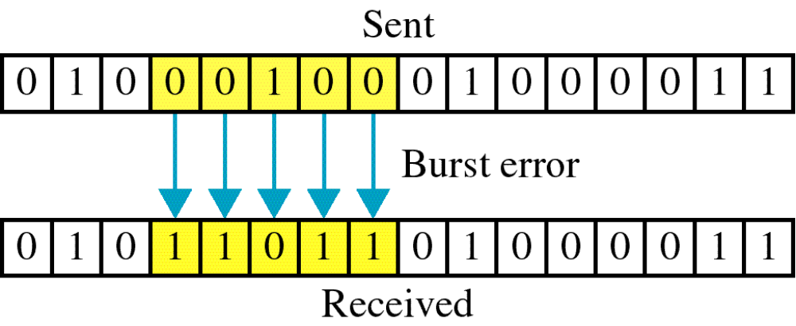
Burst error

Slide 6
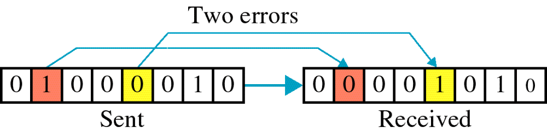

Slide 7
The term burst error means that two or more bits in the data unit have changed from 1 to 0 or from 0 to 1.
Burst errors does not necessarily mean that the errors occur in consecutive bits, the length of the burst is measured from the first corrupted bit to the last corrupted bit. Some bits in between may not have been corrupted.

Slide 8
Burst error is most likely to happen in serial transmission since the duration of noise is normally longer than the duration of a bit.
The number of bits affected depends on the data rate and duration of noise.

Slide 9
Error detection
Error detection means to decide whether the received data is correct or not without having a copy of the original message.
Error detection uses the concept of redundancy, which means adding extra bits for detecting errors at the destination.
Notes:
Make sense of message.
Make sense of message.

Slide 10
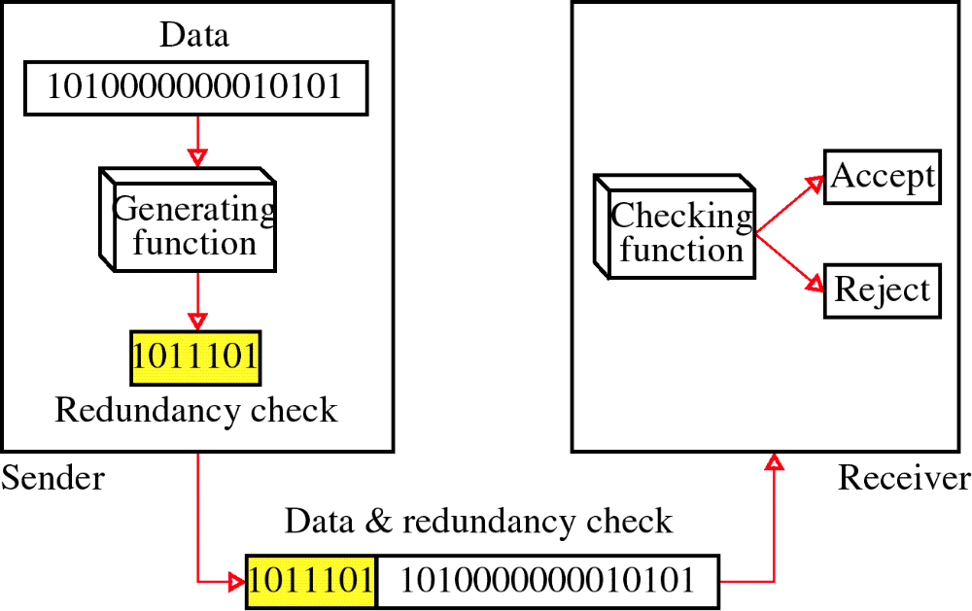
Redundancy

Slide 11
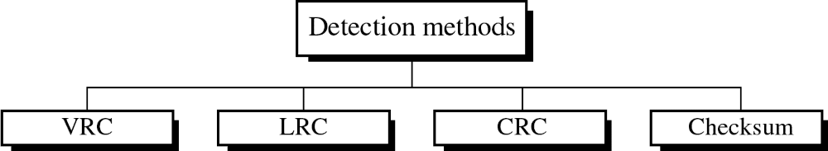
Four types of redundancy checks are used
in data communications

Slide 12
Vertical Redundancy Check
Vertical Redundancy Check is also known as Parity Check. In this method, a redundant bit also called parity bit is added to each data unit. This method includes even parity and odd parity. Even parity means the total number of 1s in data is to be even and odd parity means the total number of 1s in data is to be odd.

Slide 13
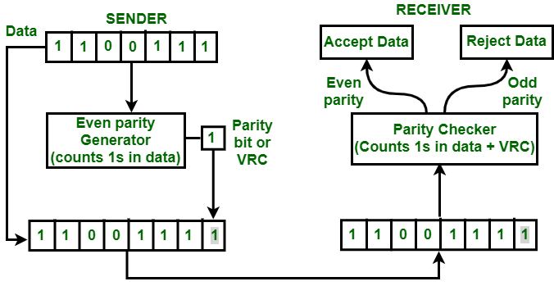
Example –
If the source wants to transmit data unit 1100111 using even parity to the destination. The source will have to pass through Even Parity Generator.
Parity generator will count number of 1s in data unit and will add parity bit. In the above example, number of 1s in data unit is 5, parity generator appends a parity bit 1 to this data unit making the total number of 1s even i.e 6 which is clear from above figure.
Data along with parity bit is then transmitted across the network. In this case, 11001111 will be transmitted. At the destination, This data is passed to parity checker at the destination. The number of 1s in data is counted by parity checker.
If the number of 1s count out to be odd, e.g. 5 or 7 then destination will come to know that there is some error in the data. The receiver then rejects such an erroneous data unit.

Slide 14
Advantages
VRC can detect all single bit error.
It can also detect burst errors but only in those cases where number of bits changed is odd, i.e. 1, 3, 5, 7, …….etc.
Disadvantages
The major disadvantage of using this method for error detection is that it is not able to detect burst error if the number of bits changed is even, i.e. 2, 4, 6, 8, …….etc.

Slide 15
Longitudinal Redundancy Check (LRC)
Longitudinal Redundancy Check (LRC) is also known as 2-D parity check. In this method, data which the user want to send is organised into tables of rows and columns. A block of bit is divided into table or matrix of rows and columns. In order to detect an error, a redundant bit is added to the whole block and this block is transmitted to receiver. The receiver uses this redundant row to detect error. After checking the data for errors, receiver accepts the data and discards the redundant row of bits.

Slide 16
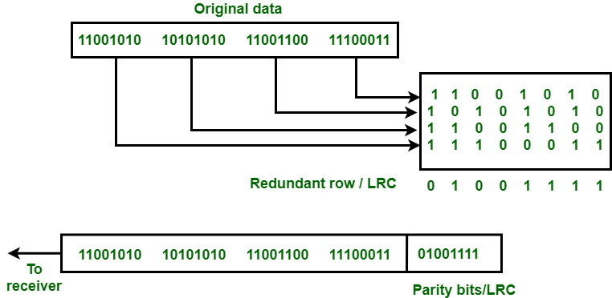
Example
If a block of 32 bits is to be transmitted, it is divided into matrix of four rows and eight columns which as shown in the following figure :
In this matrix of bits, a parity bit (odd or even) is calculated for each column. It means 32 bits data plus 8 redundant bits are transmitted to receiver. Whenever data reaches at the destination, receiver uses LRC to detect error in data.
Advantage :
LRC is used to detect burst errors.

Slide 17
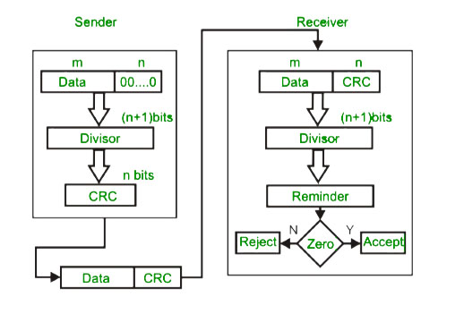
Cyclic Redundancy Check
CRC
CRC is based on binary division.
In CRC, a sequence of redundant bits, called cyclic redundancy check bits, are appended to the end of data unit so that the resulting data unit becomes exactly divisible by a second, predetermined binary number.
At the destination, the incoming data unit is divided by the same number. If at this step there is no remainder, the data unit is assumed to be correct and is therefore accepted.
A remainder indicates that the data unit has been damaged in transit and therefore must be rejected.

Slide 18
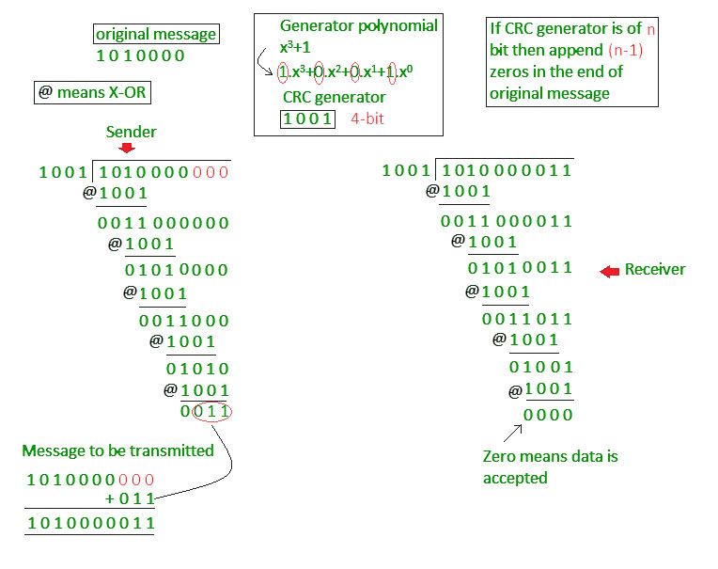

Slide 19
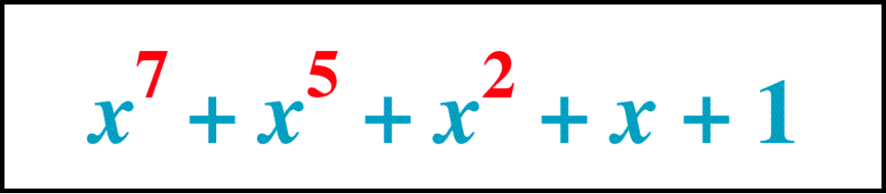
Polynomial

Slide 20
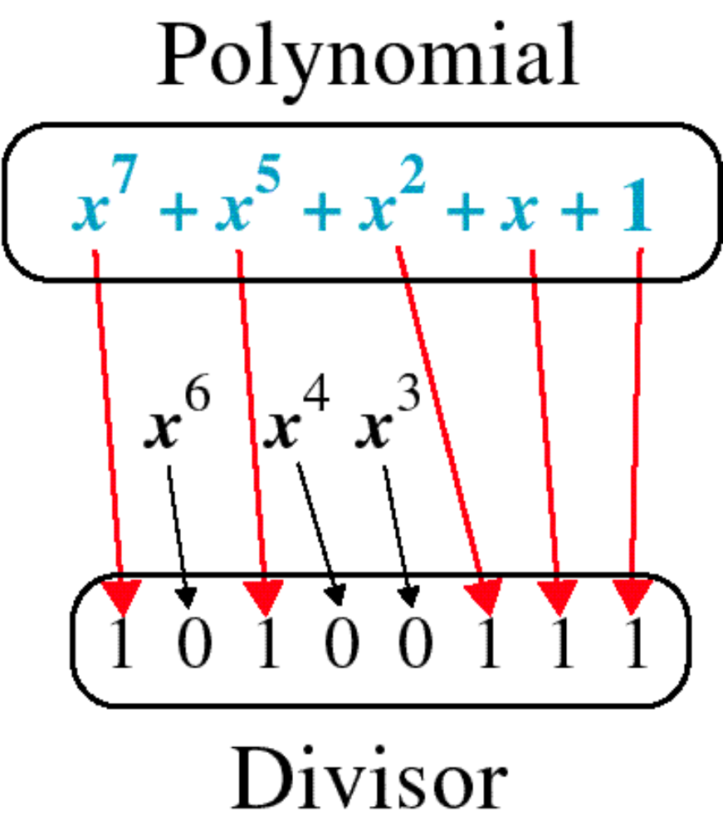
Polynomial and Divisor

Slide 21
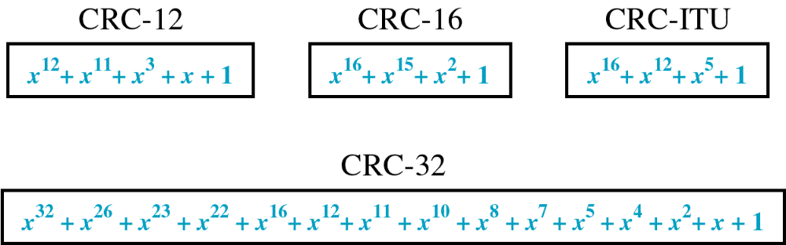
Standard Polynomials

Slide 22
Checksum
In checksum error detection scheme, the data is divided into k segments each of m bits.
In the sender’s end the segments are added using 1’s complement arithmetic to get the sum. The sum is complemented to get the checksum.
The checksum segment is sent along with the data segments.
At the receiver’s end, all received segments are added using 1’s complement arithmetic to get the sum. The sum is complemented.
If the result is zero, the received data is accepted; otherwise discarded.

Slide 23
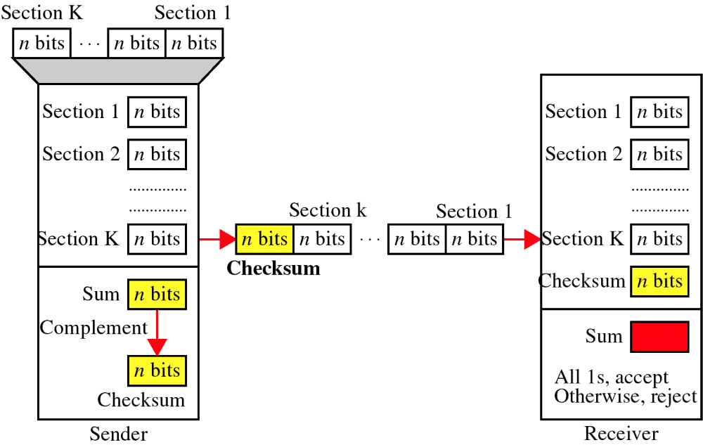
Checksum

Slide 24
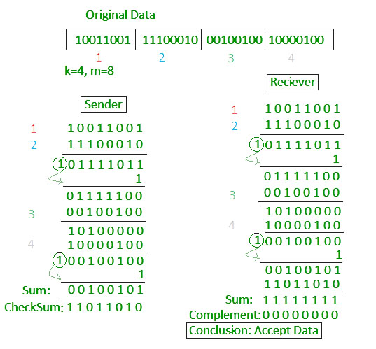

Slide 26
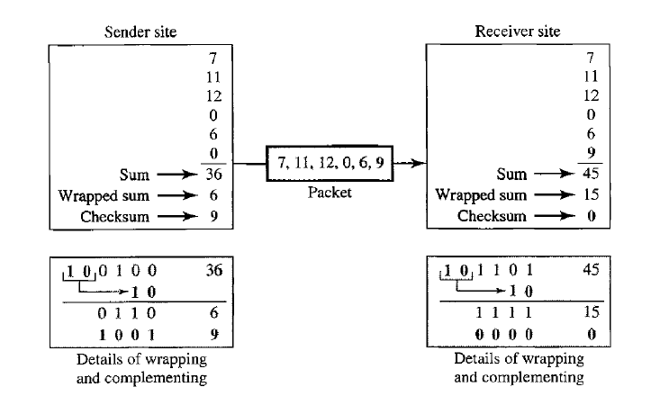

Slide 27
At the sender
The unit is divided into k sections, each of n bits.
All sections are added together using one’s complement to get the sum.
The sum is complemented and becomes the checksum.
The checksum is sent with the data

Slide 28
At the receiver
The unit is divided into k sections, each of n bits.
All sections are added together using one’s complement to get the sum.
The sum is complemented.
If the result is zero, the data are accepted: otherwise, they are rejected.

Slide 29
Performance
The checksum detects all errors involving an odd number of bits.
It detects most errors involving an even number of bits.
If one or more bits of a segment are damaged and the corresponding bit or bits of opposite value in a second segment are also damaged, the sums of those columns will not change and the receiver will not detect a problem.

Slide 30
Error Correction
It can be handled in two ways:
receiver can have the sender retransmit the entire data unit.
The receiver can use an error-correcting code, which automatically corrects certain errors.

Slide 31
Single-bit error correction
To correct an error, the receiver reverses the value of the altered bit. To do so, it must know which bit is in error.
Number of redundancy bits needed
Let data bits = m
Redundancy bits = r
∴Total message sent = m+r
The value of r must satisfy the following relation:
2^{r} ≥ m+r+1

Slide 32
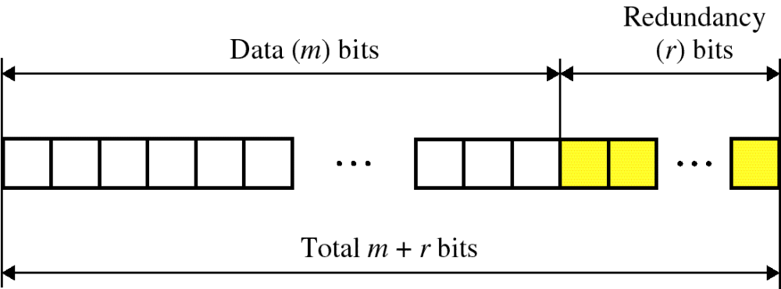
Error Correction

Slide 33
Hamming code
Hamming code is a set of error-correction codes that can be used to detect and correct the errors that can occur when the data is moved or stored from the sender to the receiver. It is a technique developed by R.W. Hamming for error correction. Redundant bits –Redundant bits are extra binary bits that are generated and added to the information-carrying bits of data transfer to ensure that no bits were lost during the data transfer.

Slide 34
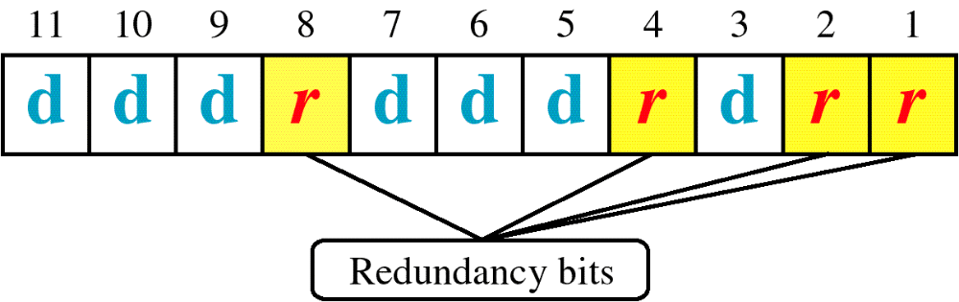
Hamming Code

Slide 35
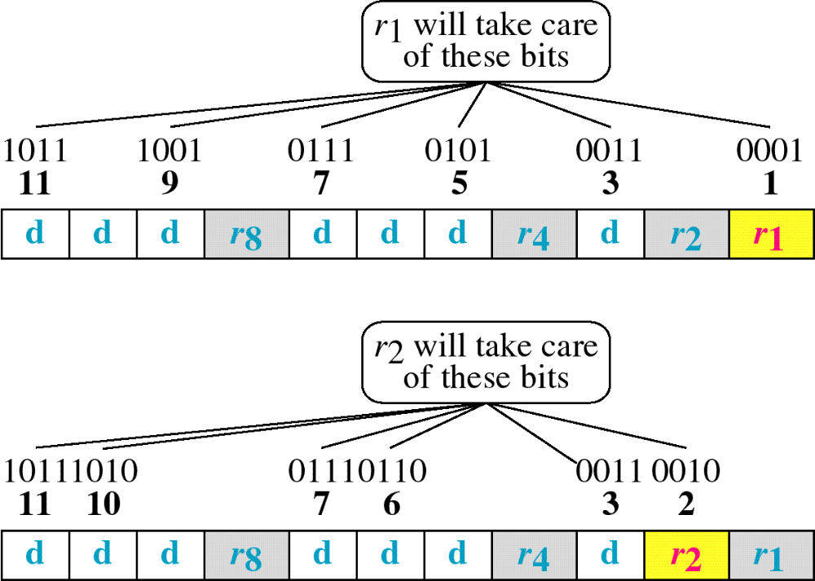
Hamming Code

Slide 36
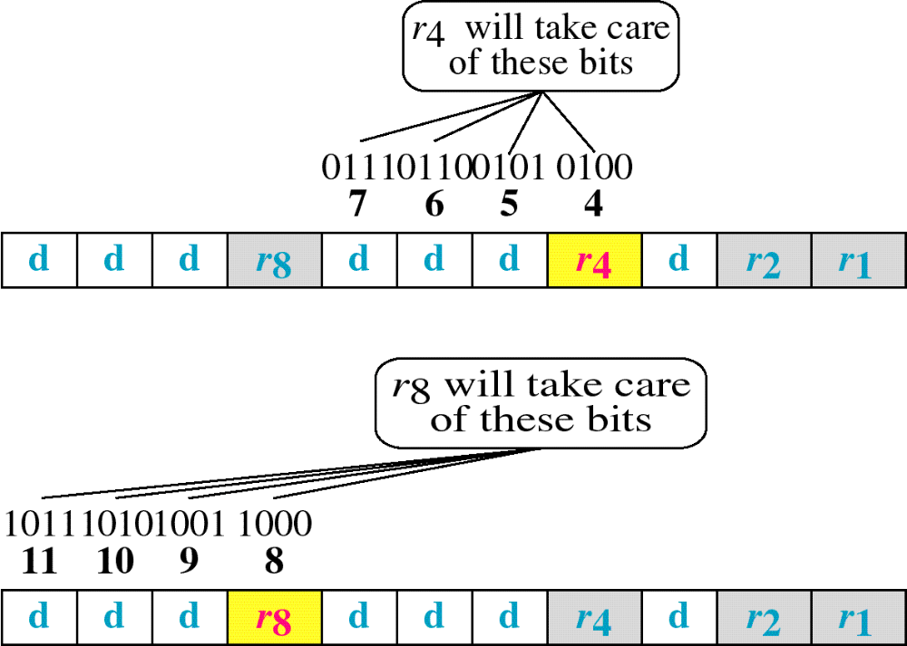
Hamming Code

Slide 37
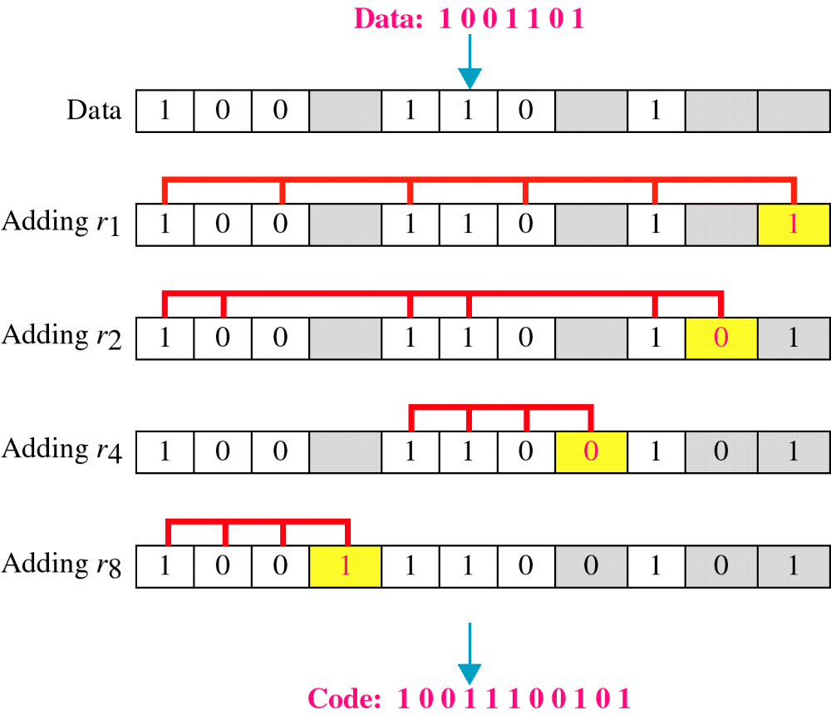
Example of Hamming Code

Slide 38
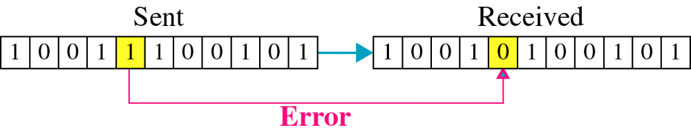
Single-bit error

Slide 39

Error
Detection

